Slide 1


Slide 2


Slide 3




DIPANSHU SAHU
INTRODUCTION
WHAT IS CYBERSECURITY ?
Cyber security refers to safe and responsible use of Internet to ensure safety and security of personal information
Scope of Cybersecurity
Cybersecurity encompasses protecting networks, systems, and data from unauthorized access, ensuring confidentiality, integrity, and availability in an ever-expanding digital world.

Slide 4




DIPANSHU SAHU
RISING CYBER CRIME AND THEIR IMPACT
Rise of Cybercrime
Cybercrime is a general term that covers crime like phising, credit card frauds, illegal downloading, cyber bulling , cyber terrisom etc
Increased Digital Dependency
Relying too much on digital services in a way that disrupts daily life
THE GROWING THREAT LANDSCAPE
Impact on People
It harms people by damaging mental health , physical well being and daily productivity through compulsive screen use

Slide 5


Slide 6


Slide 7

DIPANSHU SAHU
ONE OF THE MAJOR CYBER THREATS AND THEIR CONSEQUENCES
Phishing is a practice of attemptig to acquire sensitive information from individuals over the internet by mean of deceptions
UNDERSTANDING CYBER THREATS

Slide 8
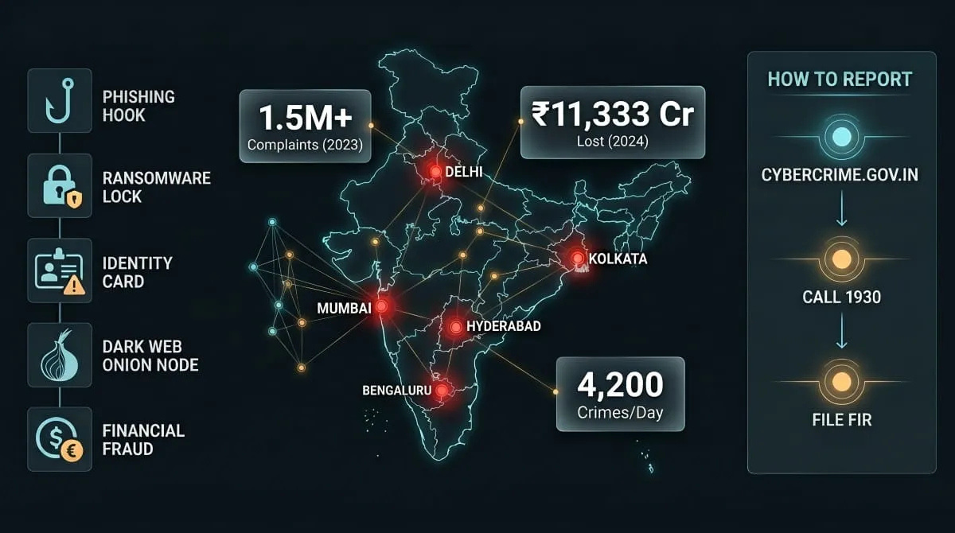

Slide 9


Slide 10


DIPANSHU SAHU
YOUR FIRST LINE OF DEFENSE - AWARENESS
BUILDING A SECURITY-CONSCIOUS MINDSET
Human Awareness
Recognising social engeneering tactics like phising emails, Fake text messages and phone call scams.
Basic Cyber Hygiene
Avoiding suspicious link ,refusing to download unknown software and logging out of sessions when finished

Slide 11


DIPANSHU SAHU
STRONG PASSWORDS & AUTHENTICATION
ENHANCING ACCESS SECURITY
Complex Passwords
Strong passwords with a mix of letters, numbers, and symbols reduce the risk of unauthorized access.rity.
Multi-Factor Authentication (MFA)
Adding extra authentication layers, like biometrics or OTPs, enhances security against credential theft.
Password Managers
Using password managers helps securely store and manage complex credentials without compromising security.

Slide 12
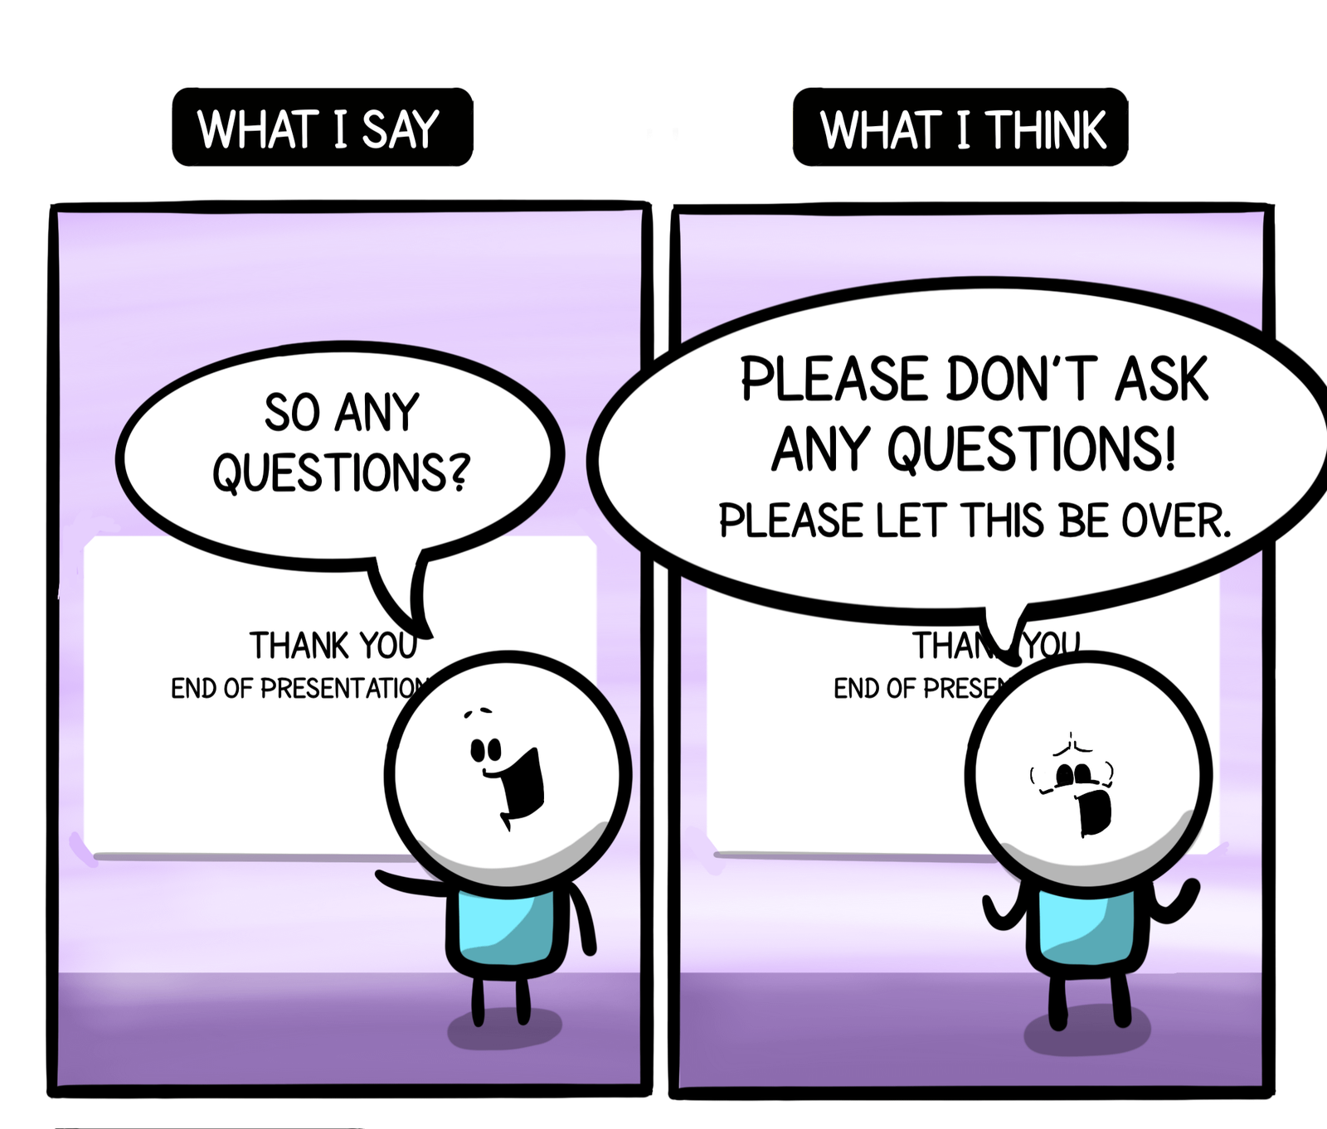

Slide 13


